Slide 1

Docker Compose

Slide 2

Why Docker Compose?
A real world application has a separate container for each of its services.
And we know that each container needs to have a Dockerfile. It means we will have to write may be hundreds of dockerfiles and then manage everything about the containers individually, and it is difficult to use or carry.

Slide 3

docker compose
docker compose, which is a tool that helps in the definition and running of multi-container applications.
With docker compose we use a single YAML file for every configuration and just single commands to start and stop all the services.
If you are using a custom image then you will need to define its configurations in a separate Dockerfile in contrast to using a prebuilt image from Docker Hub, which you can define with the docker-compose.yaml file.

Slide 4
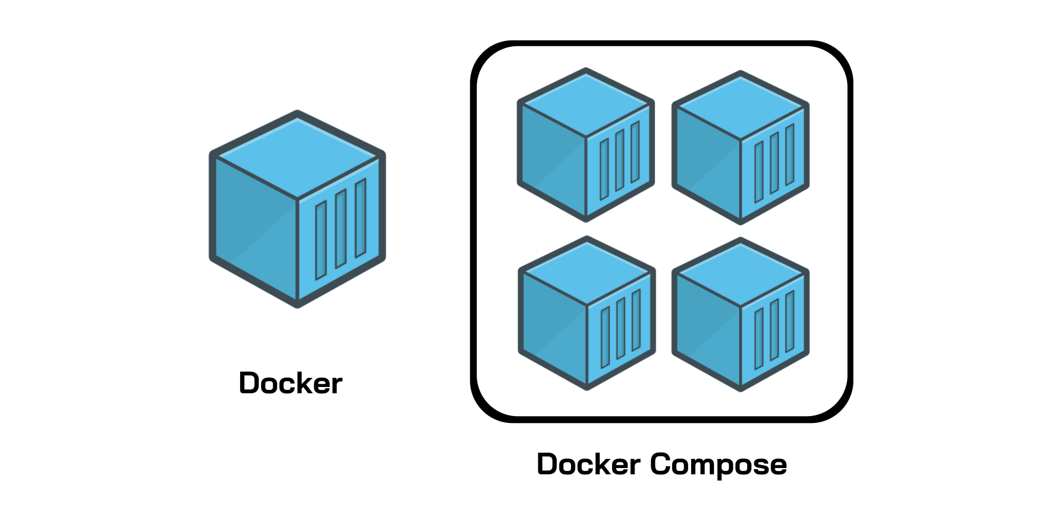

Slide 5
These are the features that docker compose support:
All the services are isolated running on the single host.
Containers are recreated only when their is some change.
The volume data is not reset when creating new containers, volumes are preserved.
Movement of variables and composition within environments.
It creates a virtual network for easy interaction within the environments.

Slide 6

Docker-Compose installation
sudo apt install docker-compose
To check the version :
docker-compose –v
Docker-compose version

Slide 7

Allows to run multi-container Docker applications reading instructions from a docker-compose.yml file

Slide 8

YAML File
YAML is a data serialization language that matches user’s expectations about data.
It designed to be human friendly and works perfectly with other programming languages.
It is useful to manage data and includes Unicode printable characters.

Slide 9
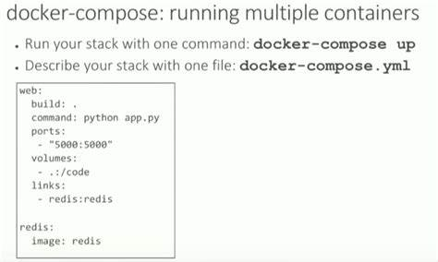

Slide 10
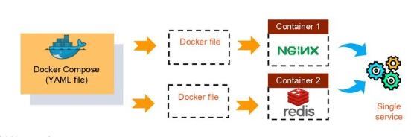

Slide 11
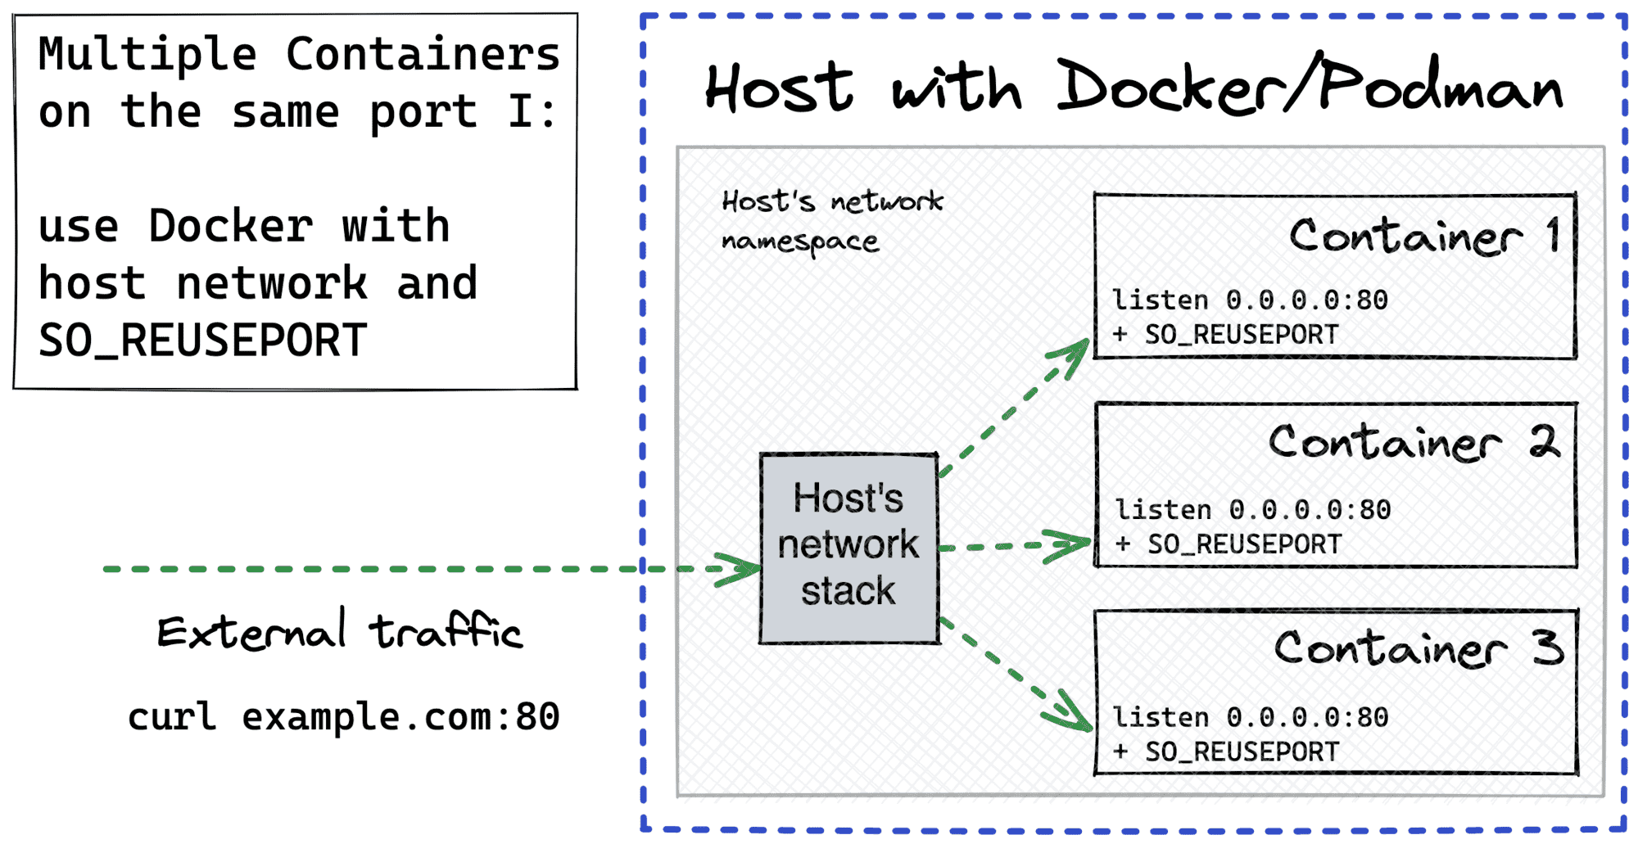
Notes:
x

Slide 12
Building Blocks of Docker Compose
Services
Volumes
Networking

Slide 13
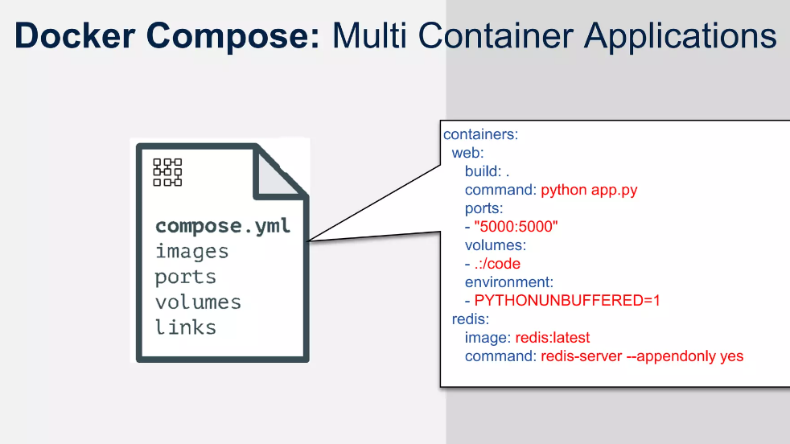

Slide 14
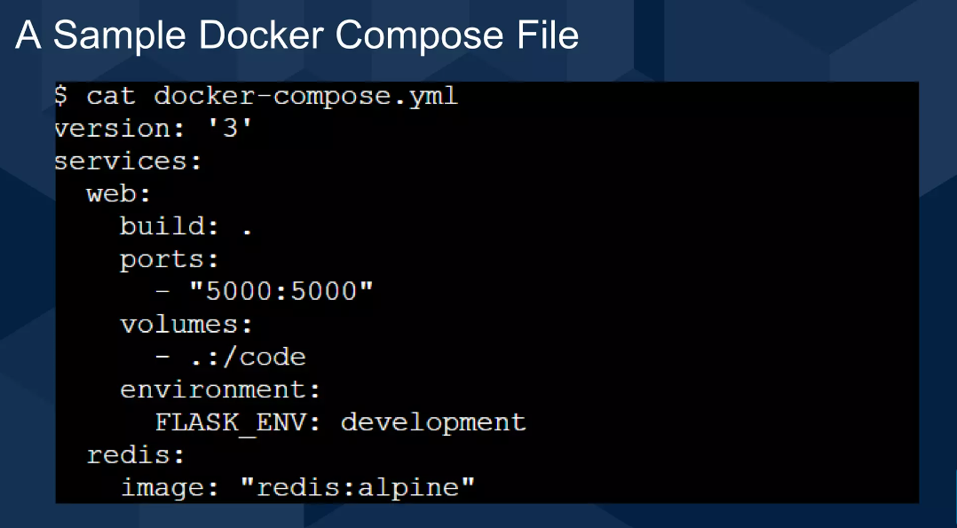

Slide 15

Docker Compose compatibility matrix

Slide 16
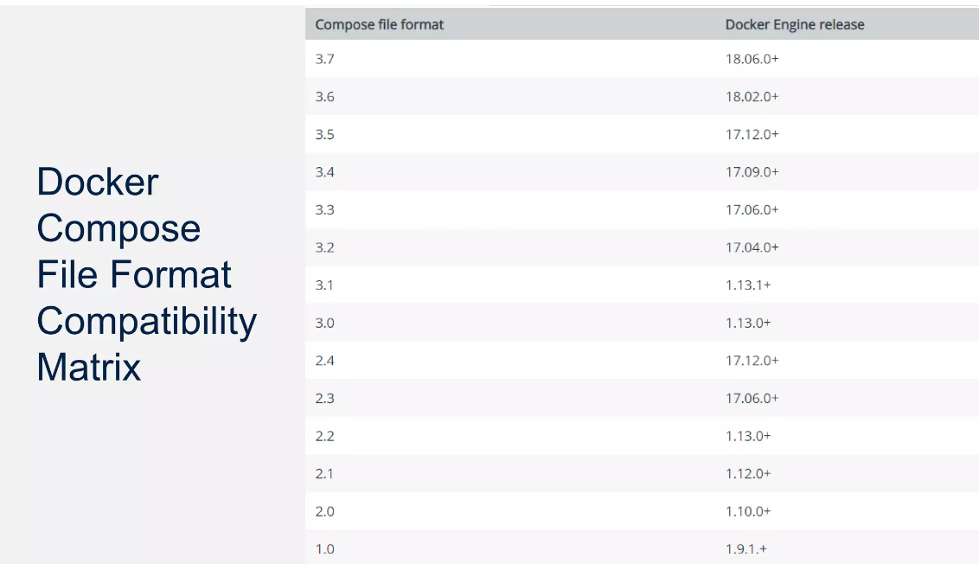

Slide 17

Environment variable In docker-compose

Slide 18
To pass the environment variables to the containers, you can use the environment key in a docker-compose.yml file.

Slide 19
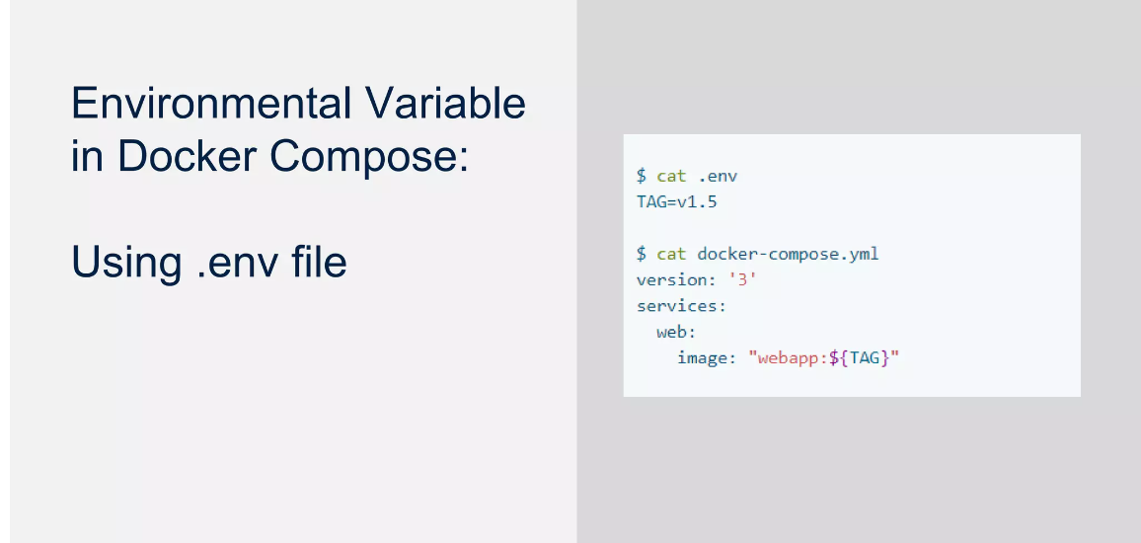

Slide 20
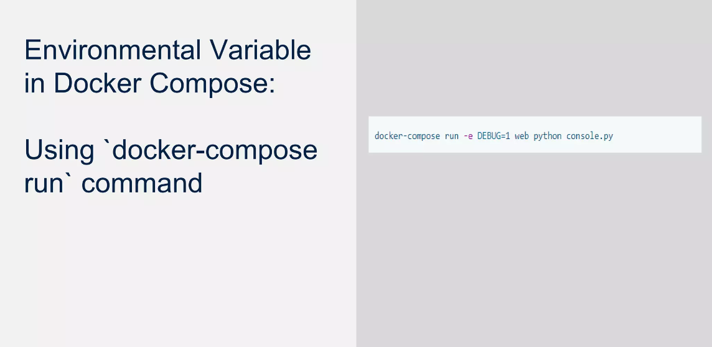

Slide 21
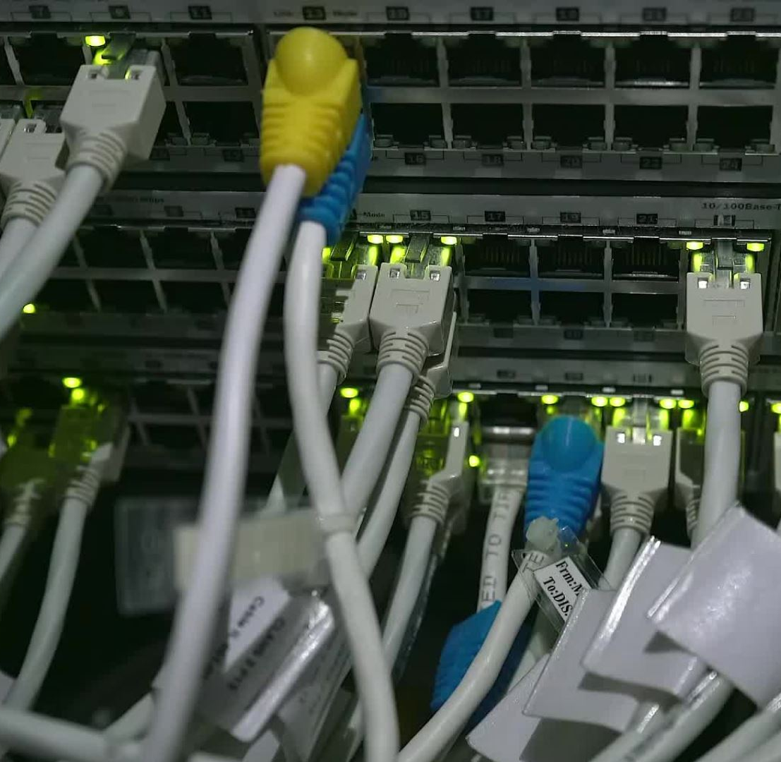
Networking in Compose

Slide 22
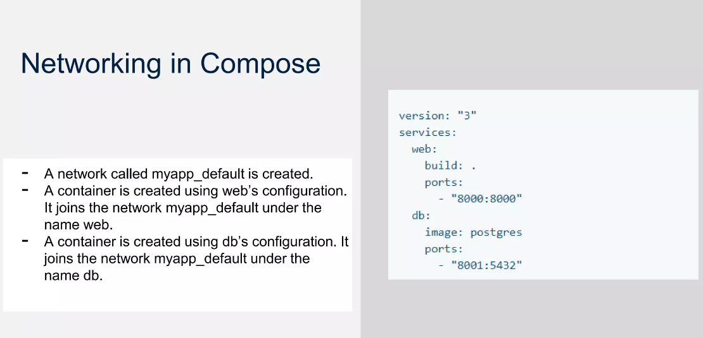

Slide 23
Networking Basics
docker network ls

Slide 24
You can alter the network name with the -p or --project-name flags or the COMPOSE_PROJECT_NAME environment variable. (In the event you need to run multiple projects on a single host, it’s recommended to set project names via the flag.)

Slide 25
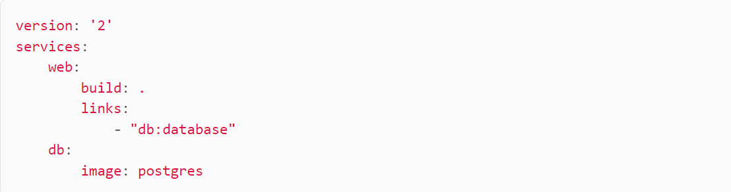
Linking Containers
You may define additional aliases that services can use to reach one another. Services on the same network can already reach one another. In the example below, we allow web to reach db via one of two hostnames (db or database):

Slide 26
If you do not specify a second hostname (for example, - db instead of - "db:database"), Docker Compose uses the service name (db). Links express dependency like depends_on does, meaning links dictate the order of service startup.

Slide 27
Networking with Multiple Hosts:
You may use the overlay driver when deploying Docker Compose to a Swarm cluster. We’ll cover more on Docker Swarm in a future article.

Slide 28
